Slide 1
Making requests

Slide 2
When will you use requests? > Favors > Permission Today we will focus on requests when we want to order food!

Slide 3
In English we MUST NEVER use “I want” to order food. It can been seen as unpolite and rude. So how do we order food in English?

Slide 4
We use these modal verbs: 1) Can I 2) May I 3) Could I 4) I would like

Slide 5
They can be formal or informal: 1) Can I (informal) 2) May I (++formal) 3) Could I (++neutral) 4) I would like (+neutral) 5) I will have (neutral)

Slide 6

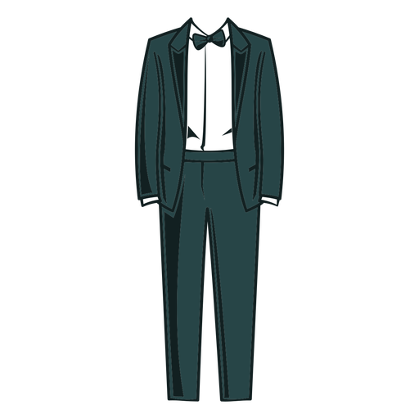
More formal: May I have a cup of tea, please? May I have some water, please?

Slide 7
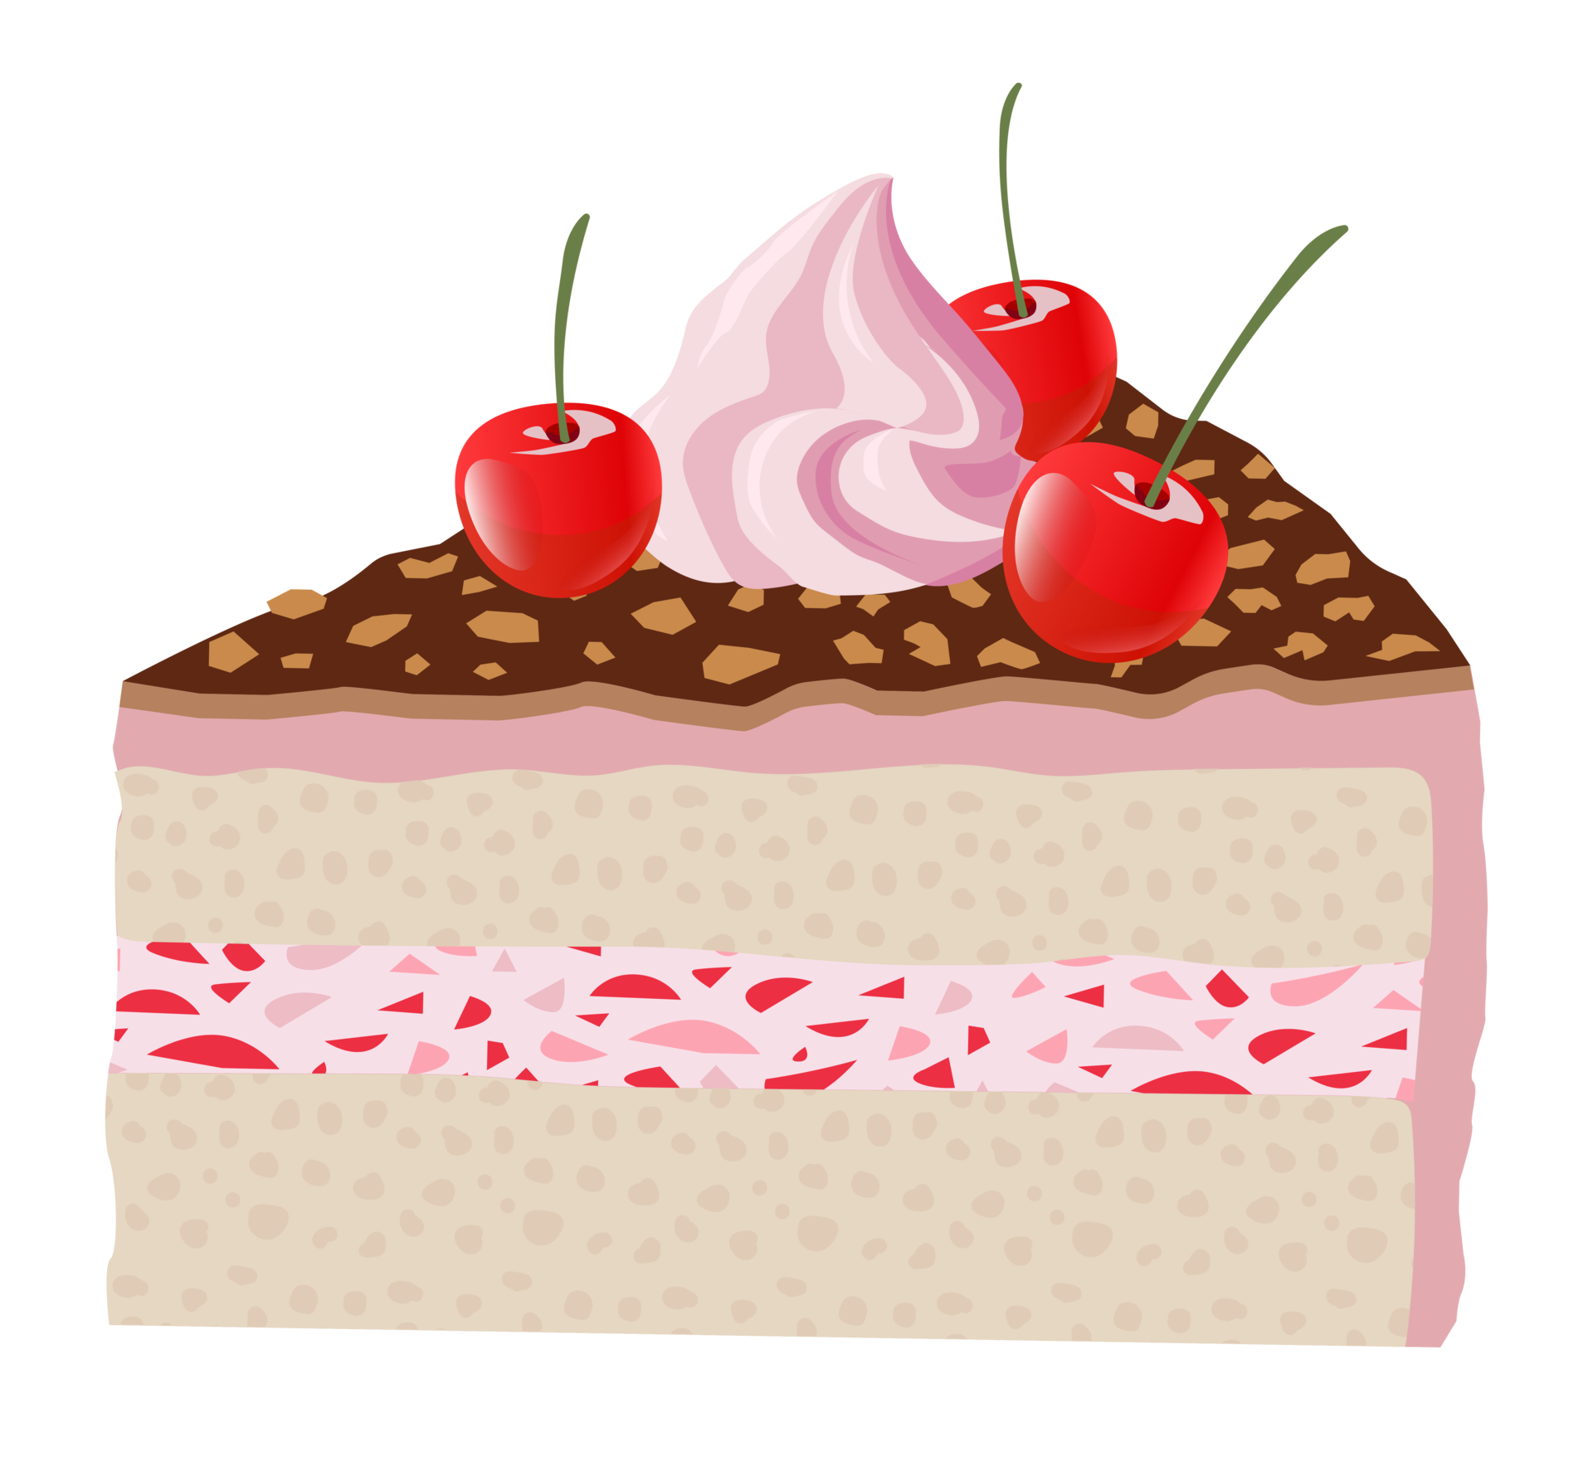
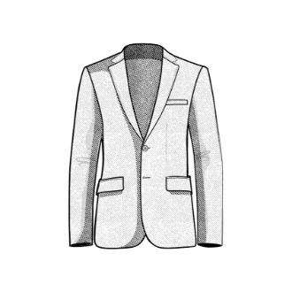
Formal: Could I have a double cheeseburguer, please? Could I have some cake, please?

Slide 8
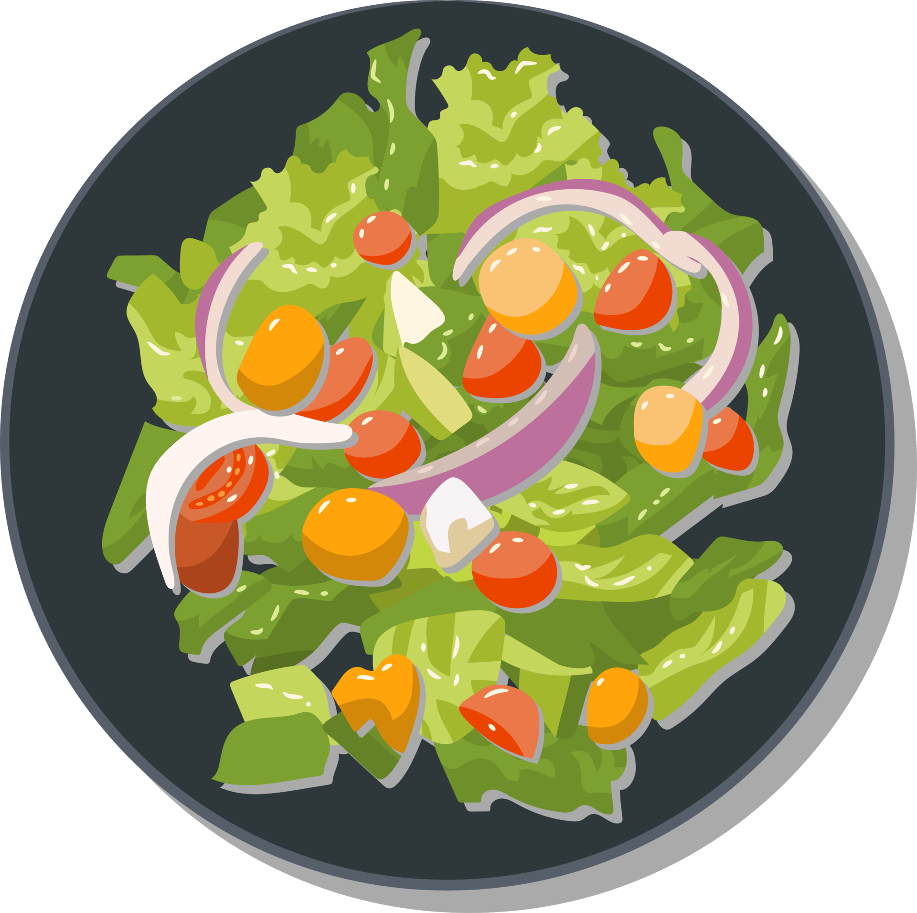
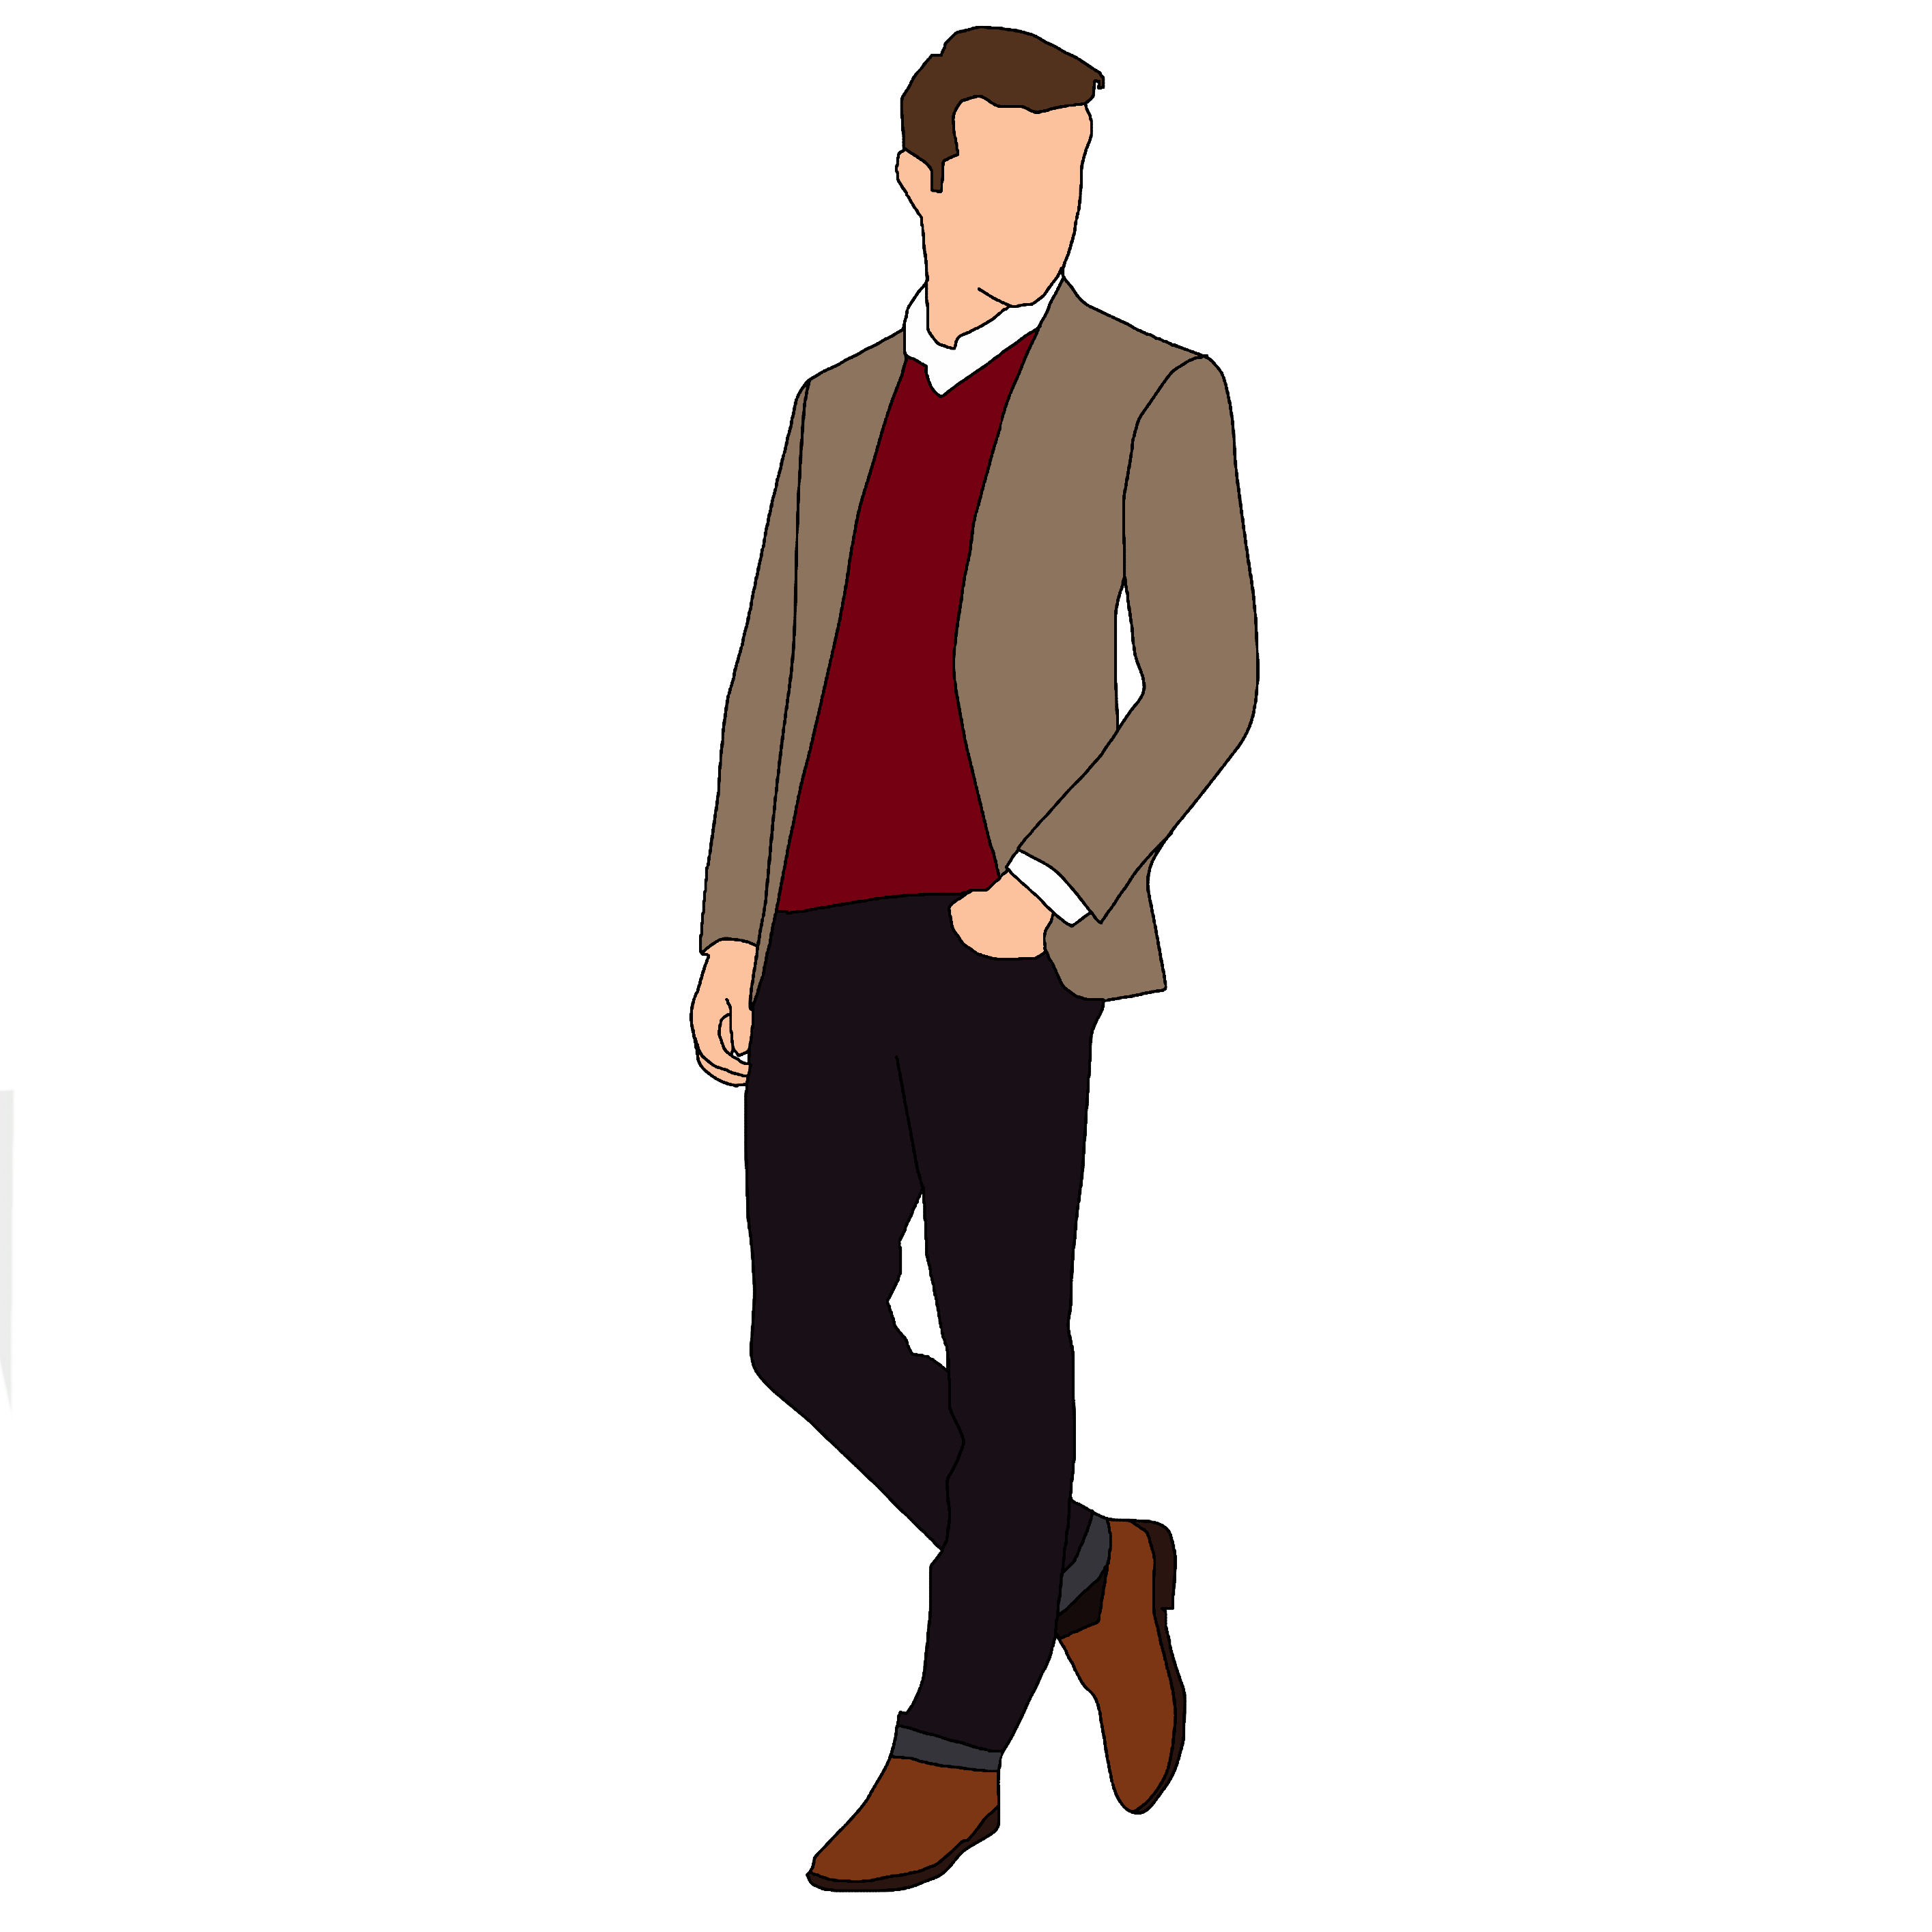
Neutral: I would like a glass of wine, please. I would like a salad, please.

Slide 9
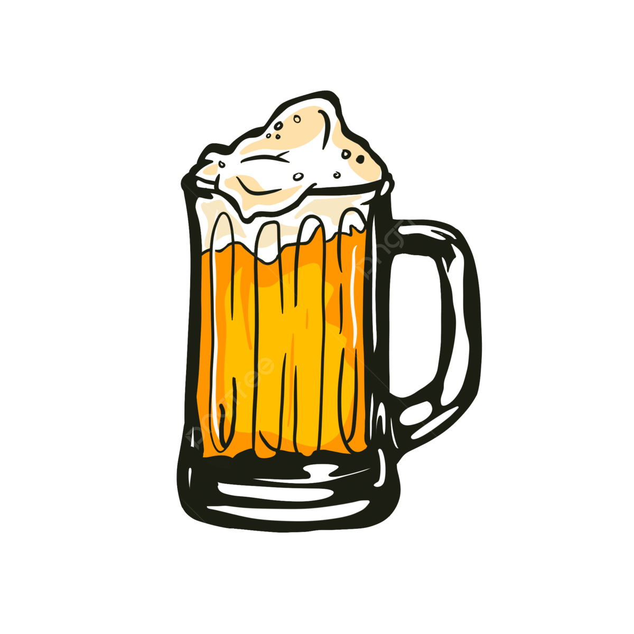

Neutral: I’ll have some carbonara, please. I’ll have a beer, please.

Slide 10

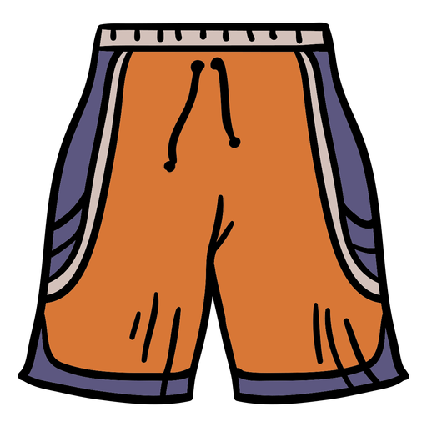
Informal: Can I have a hot dog, please? Can I get a burrito, please?

Slide 11

Now it’s time to practice!

